Slide 1
vPIPE: A Virtualized Acceleration System for
Achieving Efficient and Scalable Pipeline
Parallel DNN Training
Du Xiao - November, 5th, 2021

Slide 2
Motivation
First, as the system injects multiple input batches, it should carefully manage all stages’ training memory to avoid exceeding the physical memory capacity on any GPU.
Second, to maximize the efficiency, the system should enforce a “balanced” partition such that all stages achieve roughly the same high throughput.

Slide 3
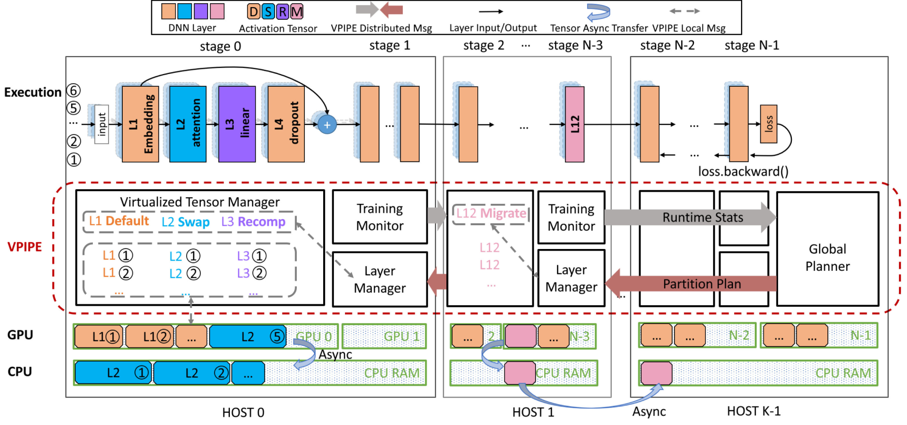
Vpipe’s Architecture
Virtualized Tensor Manager,Training monitor , Layer manager, Global planner

Slide 4
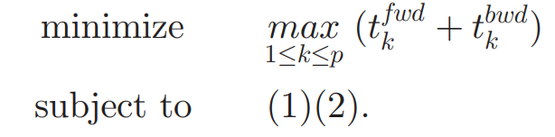
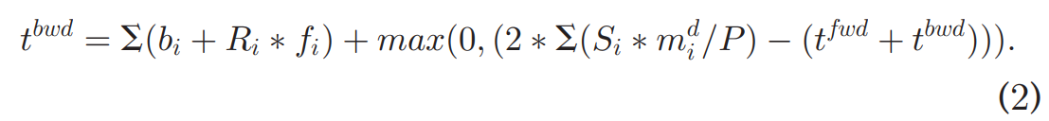
Model
Memory:
Time:

Slide 5
swap, recompute and partition
Problem1: stage partition is constant, and each stage locally finds a swap and recompute plan(stage partition) depending on its GPU resource.
Goal1: reduce the memory footprint with the lowest overhead.
solution 1: VPIPE oversees the runtime statistics of each forward pass and its backward pass to precisely predict the arrival time of each backward pass execution
solution 2: sets priorities to different asynchronous streams that pass
through PCIe.
Problem2: memory management policy is constant, and stages should
be repartitioned.
solution: multi-level graph partition schemes based Kernighan-Lin (KL) algorithm (complex DNN is usually constructed as a coarsened graph of repeated subgraphs, detect intra edges inside subgraphs and nested edges among subgraphs, leverage the time series distance collected at runtime execution.)

Slide 6
Live Layer Migration
Existing pipeline parallel system: stop the runtime, modify the layer partition configuration, and reboot the whole training process.
VPIPE : use the subtle interleaving the time window between the activation generation (in a forward pass) and its final usage (in the corresponding backward pass) a subtle interleaving.

Slide 7
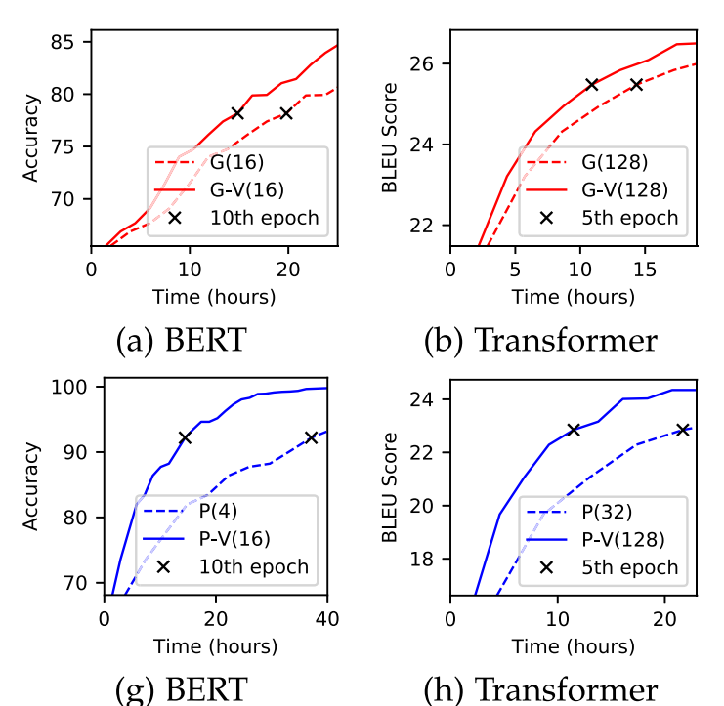
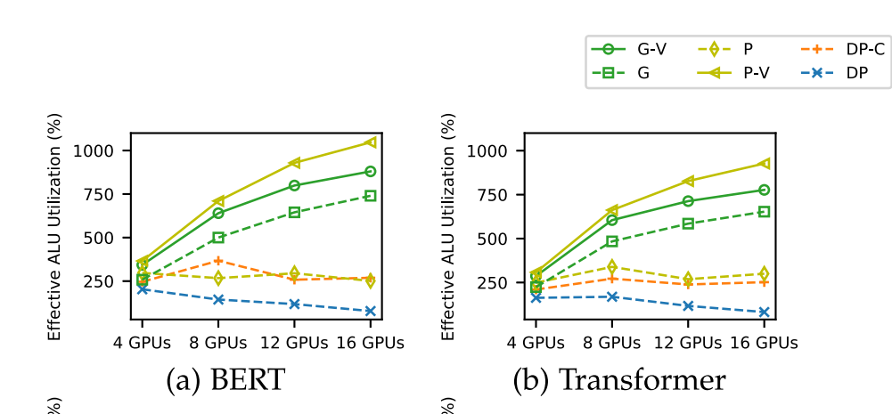
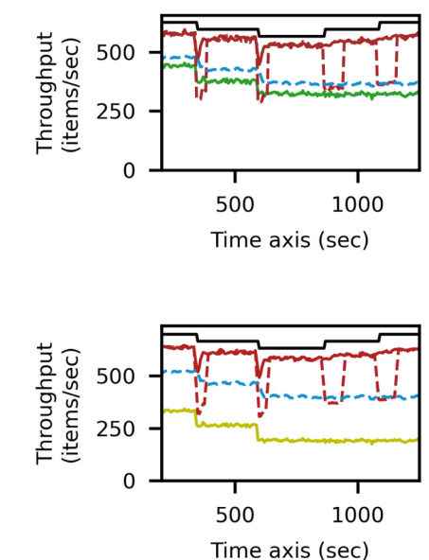
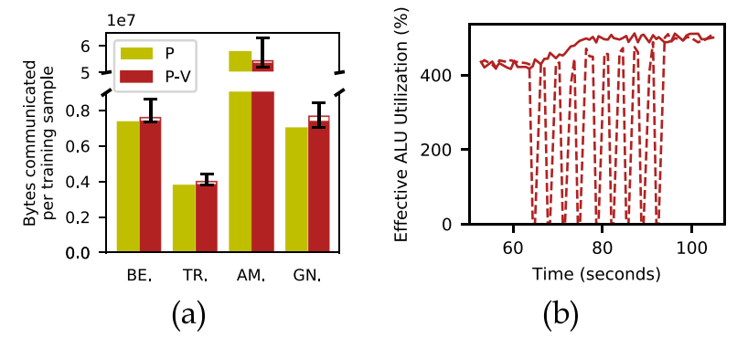
Evaluation
baseline: Pipedream (Asp) and GPipe (Bsp)
Metrics:
VPIPE’s efficiency on static DNN training
scalability
VPIPE’s efficiency on dynamic DNN
training
effective of VPIPE’s runtime algorithms

Slide 8
limitations
There might exist special DNNs where the execution time of all layers is extremely short, while a layer holds a non-negligible amount of data to transfer.

